Slide 1

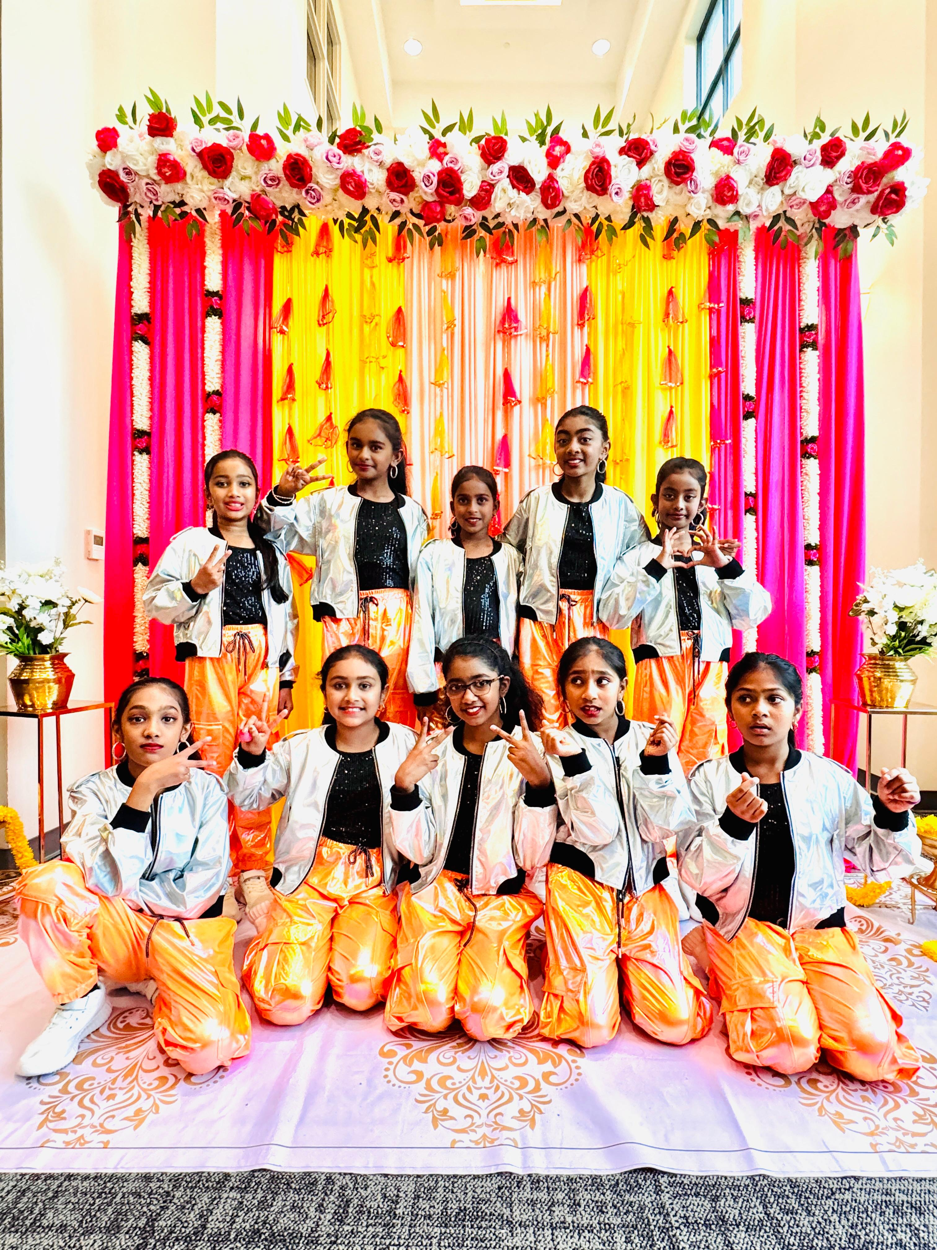
Dhriti Shaju Humaira Zaheer Lina Shahin Mohamed Musthaba Magathi Ganesh Prarthana Lal
Riyasri Rammohan Sanjana Senthil Thiya Sakthi Yuthika Rajesh
DK10
Notes:
Image: DK10.jpeg

Slide 2
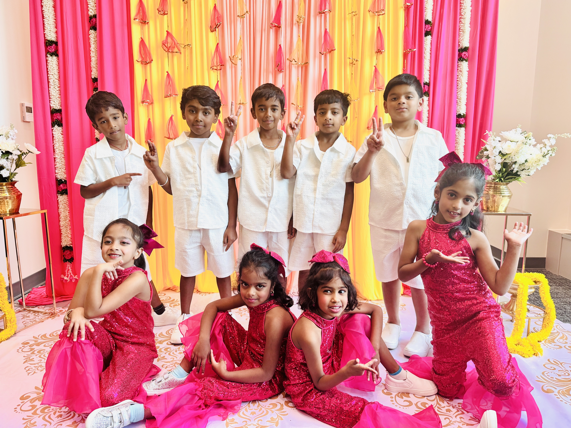
Aarush Chetty Aditi Lakshmi Kanth Arjun Senthil Daksh Yenuganti Joshika Sankaranarayanan
Maithri Iyengar Mohamed Aqeel Mohamed Musthaba Naren Neelakantan Niharika Sivaraj Yeshas Reddy Ramireddy
DK17
Notes:
Image: DK17.jpg

Slide 3
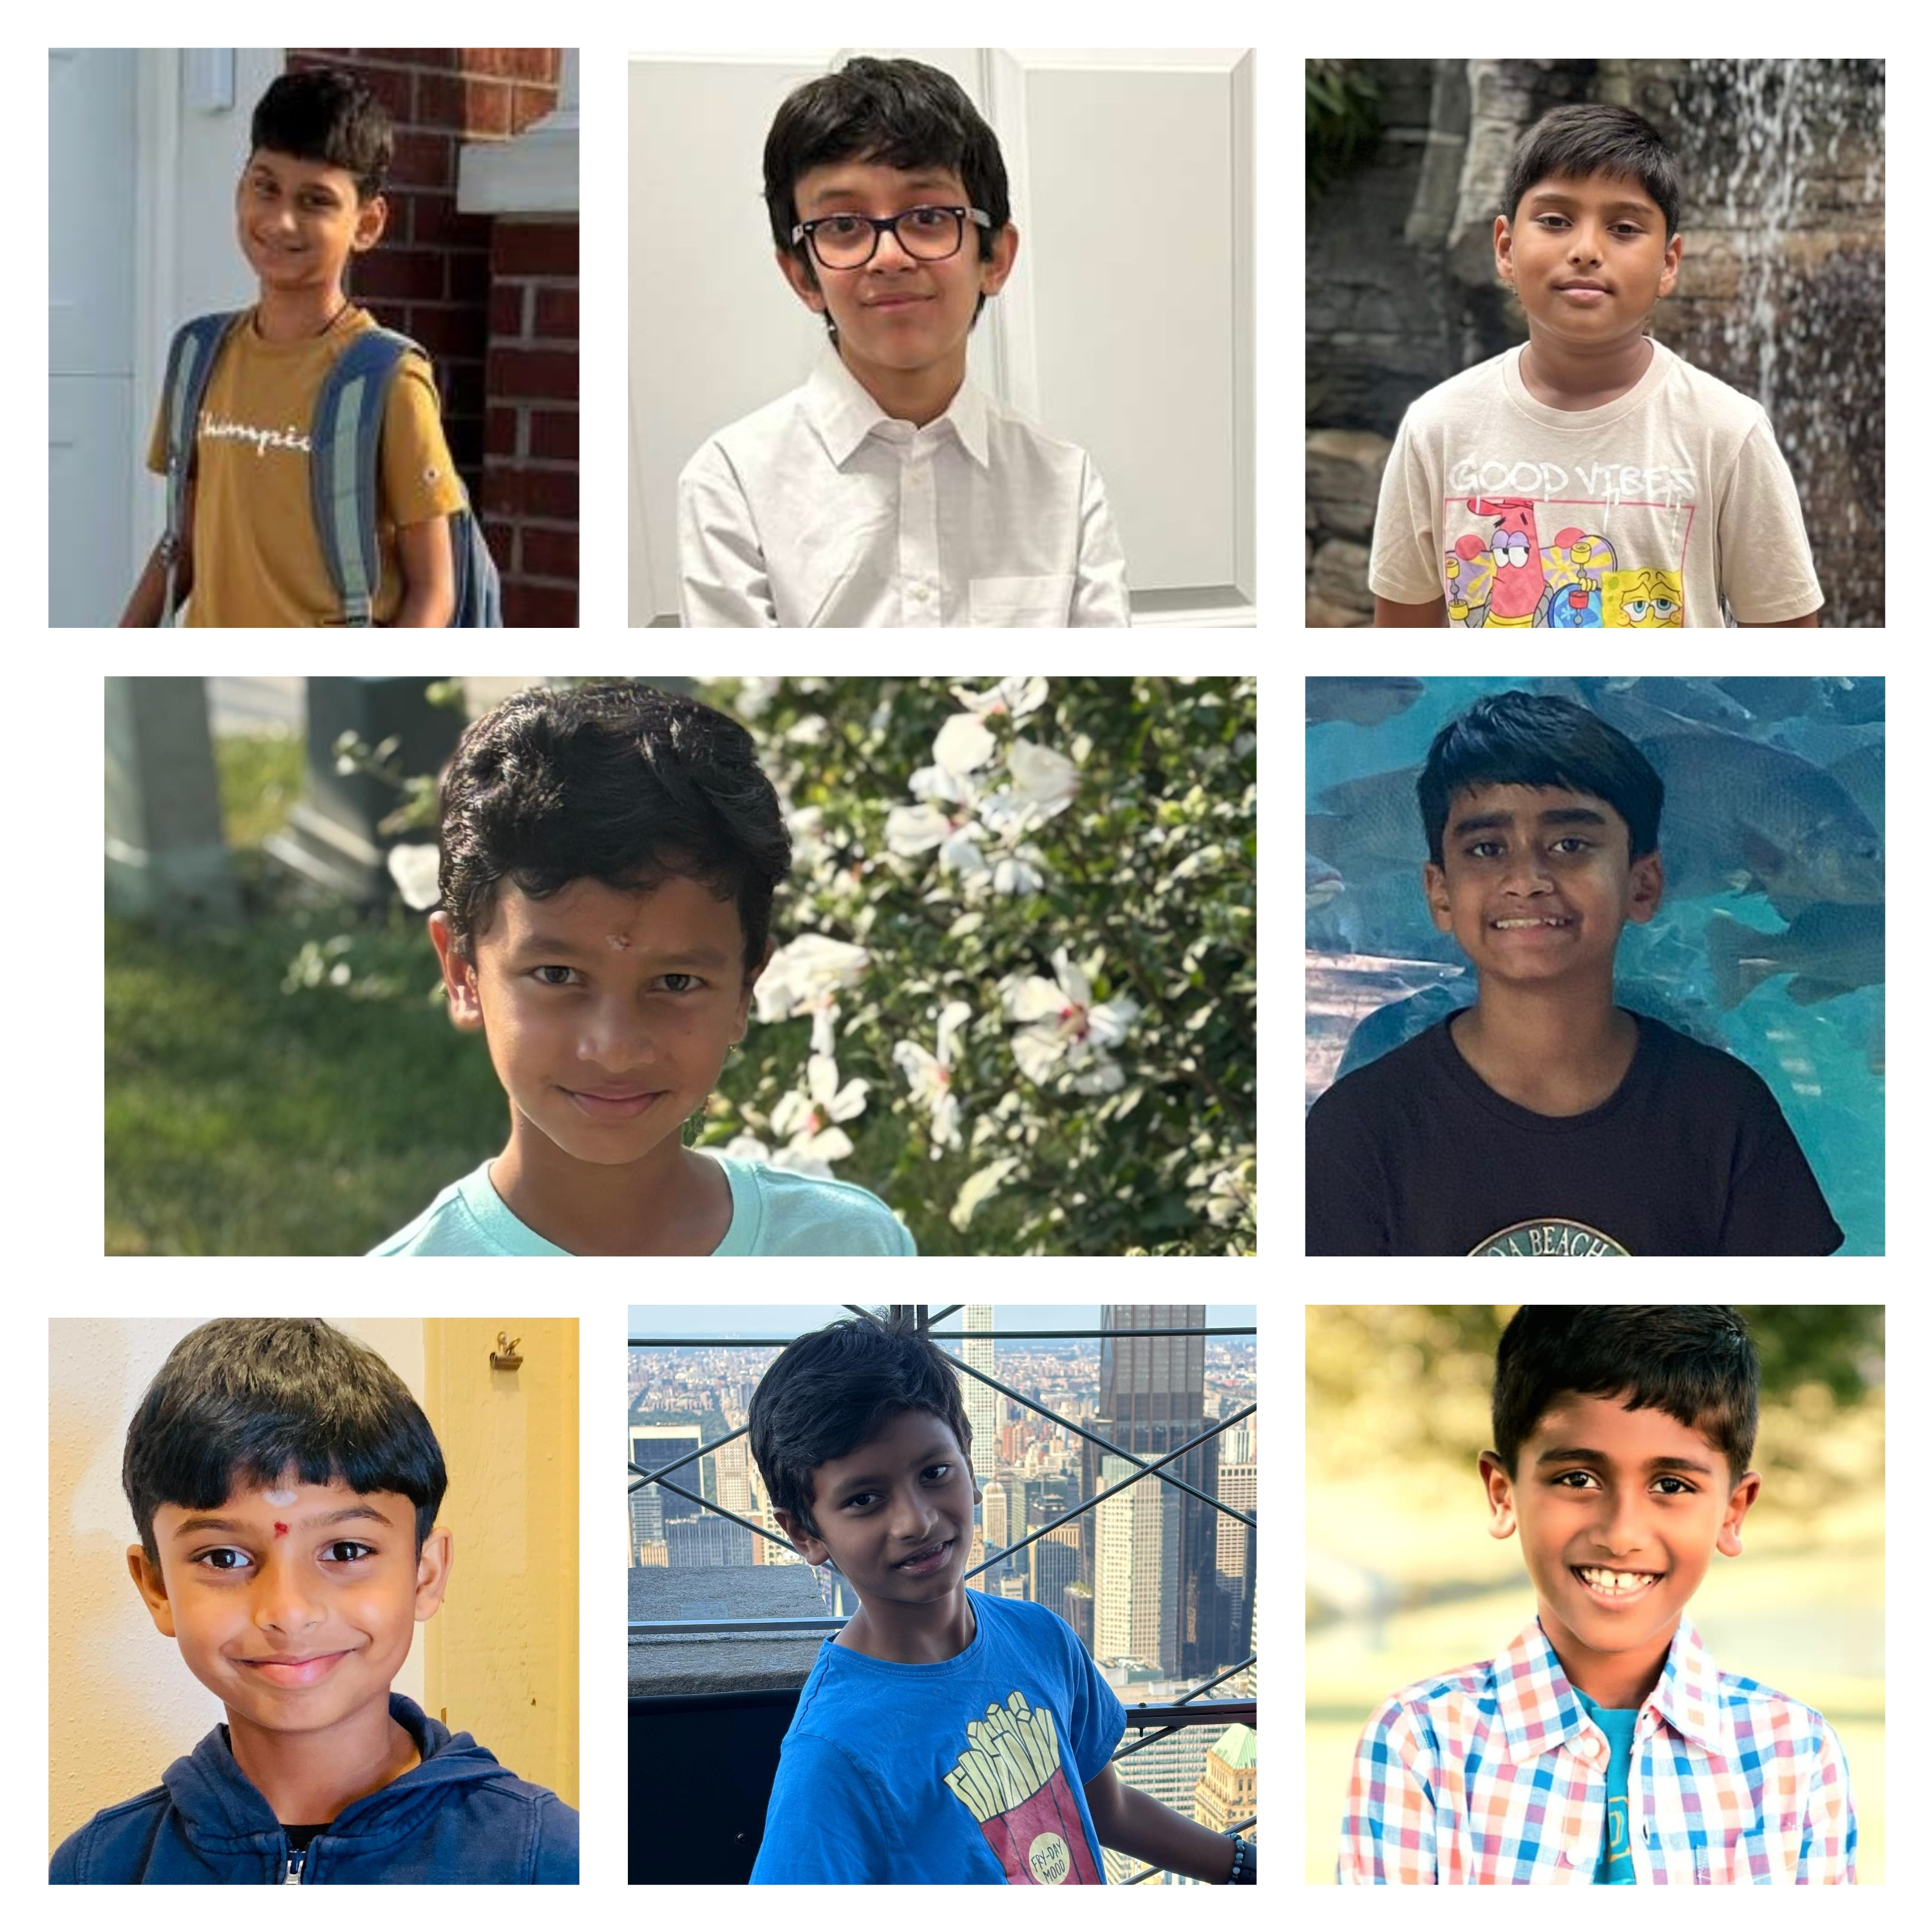
Akshagan Prakash Devanand Anandbabu Dhanvanth Venkatraman Pradeesh Prakash
Pranav Suresh Rishik Aditya Ganesh Srinath Ramachandran Vishak Gunta
DK05
Notes:
Image: DK05.jpg

Slide 4
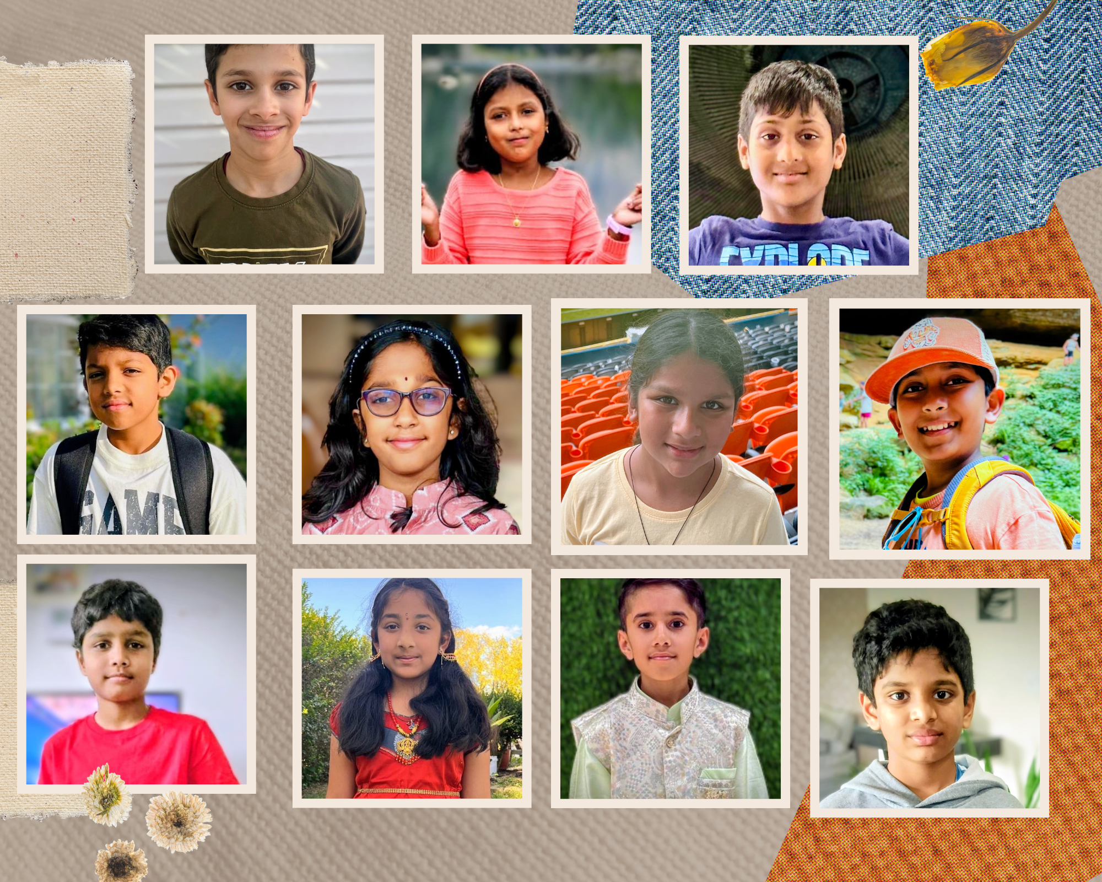
Adhvay Arun Anushka Mahajan Deethya Brahmadevara Johannes Kaliyadan Riketha Menon
Rishi Yalavarthi Rishvita Peddireddy Sanjeev Ravuri Thrinayan Sai Katkuri Vihaan Somashekar
DK31
Notes:
Image: DK31.jpg

Slide 5
Insert Photo
Makkal Isai Neram
Notes:
Image not found. ImageFile=''. Also tried from SlideName='Makkal Isai Neram'. Searched in: ['/Users/AB74296/Downloads/DK PPT', '/Users/AB74296/Downloads/DK PPT/images', '/Users/AB74296/Downloads/DK PPT/imgs', '/Users/AB74296/Downloads/DK PPT/photos']

Slide 6
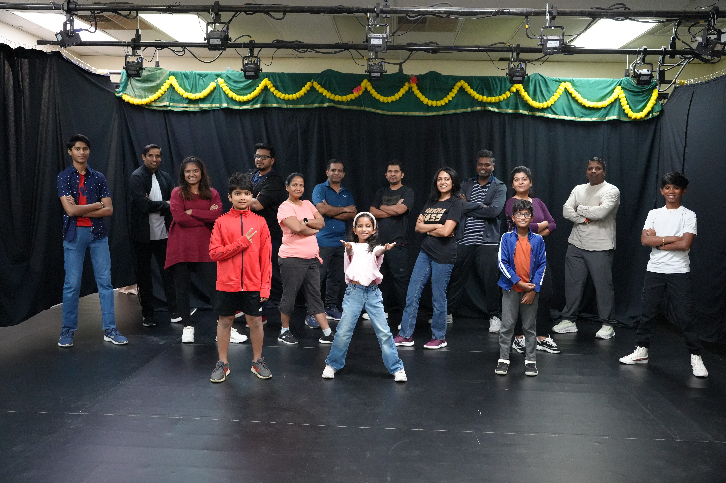
Aaryan Prasob Chinna Bala Deepa Dilip Deepika Kalaiyarasan Esra Sanjo Geetha Nat Jai Natarajan Murasumanivelan Padma Sundari Jothi Selvanayakam Prabu Gokulanandam
Rishivanth Vijayanand Samjeyadurai R Sanjith Sivan Senthil Karmegam Siddharth Sunish Supriya Dhanraj Uday Sekar Vibhu Vinodhan Murasumanivelan Vilina Viyaan Siva Shankar
DK03
Notes:
Image: DK03.JPG

Slide 7
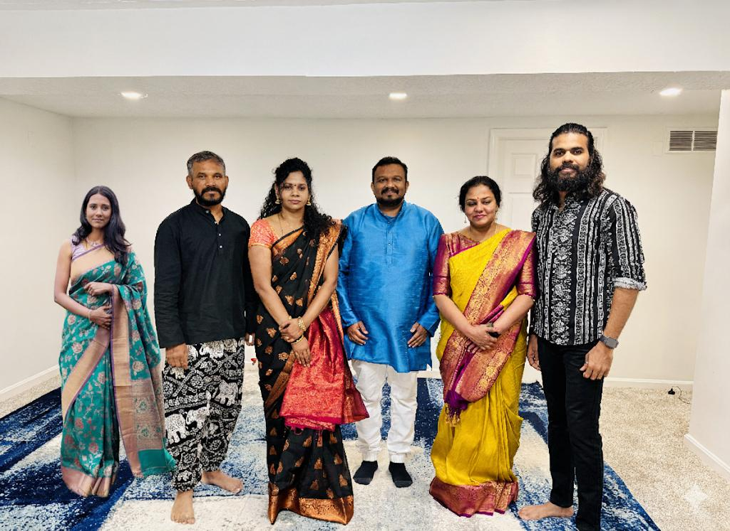
Nisha Nair Rajmohan Kamaraj Ramya Arun
Sathya Subramanian Sunish Sasidharan Vetriilaval Arthipriya
DK07
Notes:
Image: DK07.jpg

Slide 8
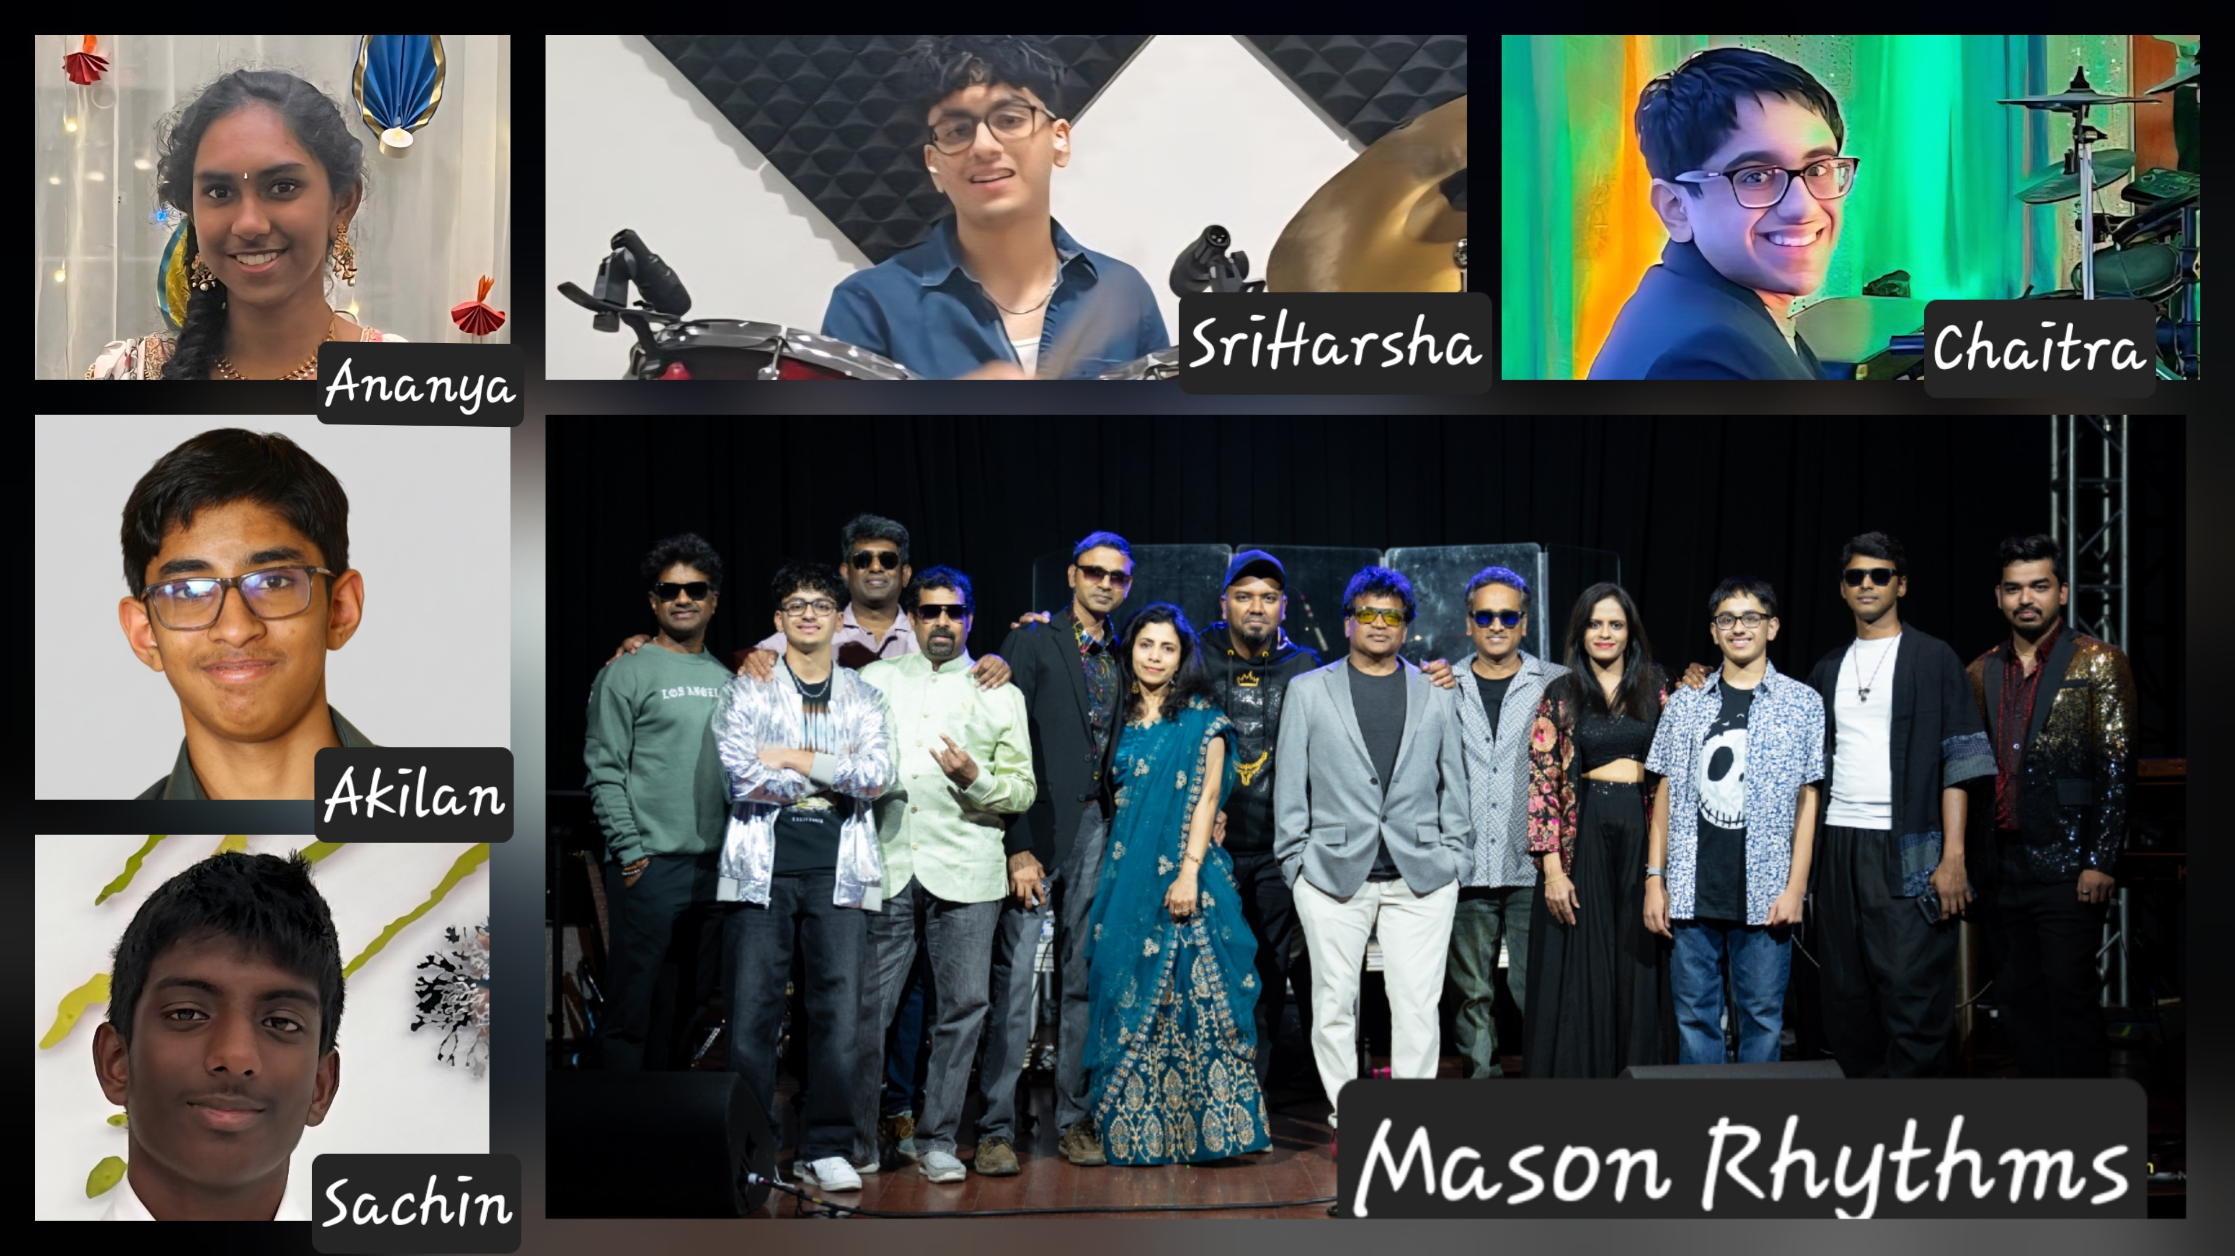
Akilan Sivabalan Ananya Kamaraj Barani Bhavani Shankar Dilip Jayashree Jingu
Noah Mel Gibzon Pradeep Radhika Sachin Ammula Srichaitra Gudimetla Sriharsha Gudimetla Sridhar
DK43
Notes:
Image: DK43.jpg

Slide 9
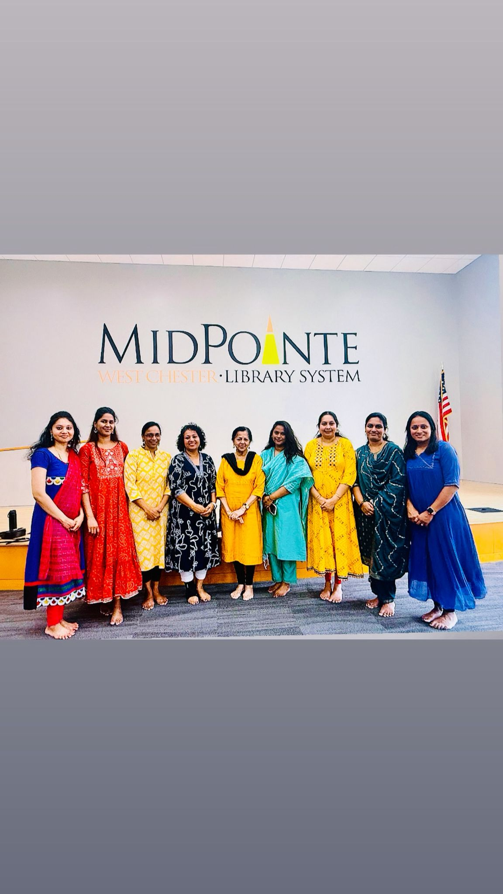
Archana Arthi Asha Bhavya Ishwarya
Iswarya Prakash Lakshmi Nirmala Saritha Vidhya
DK15
Notes:
Image: DK15.jpg

Slide 10
Insert Photo
GCTS Sports
Notes:
Image not found. ImageFile=''. Also tried from SlideName='GCTS Sports'. Searched in: ['/Users/AB74296/Downloads/DK PPT', '/Users/AB74296/Downloads/DK PPT/images', '/Users/AB74296/Downloads/DK PPT/imgs', '/Users/AB74296/Downloads/DK PPT/photos']

Slide 11
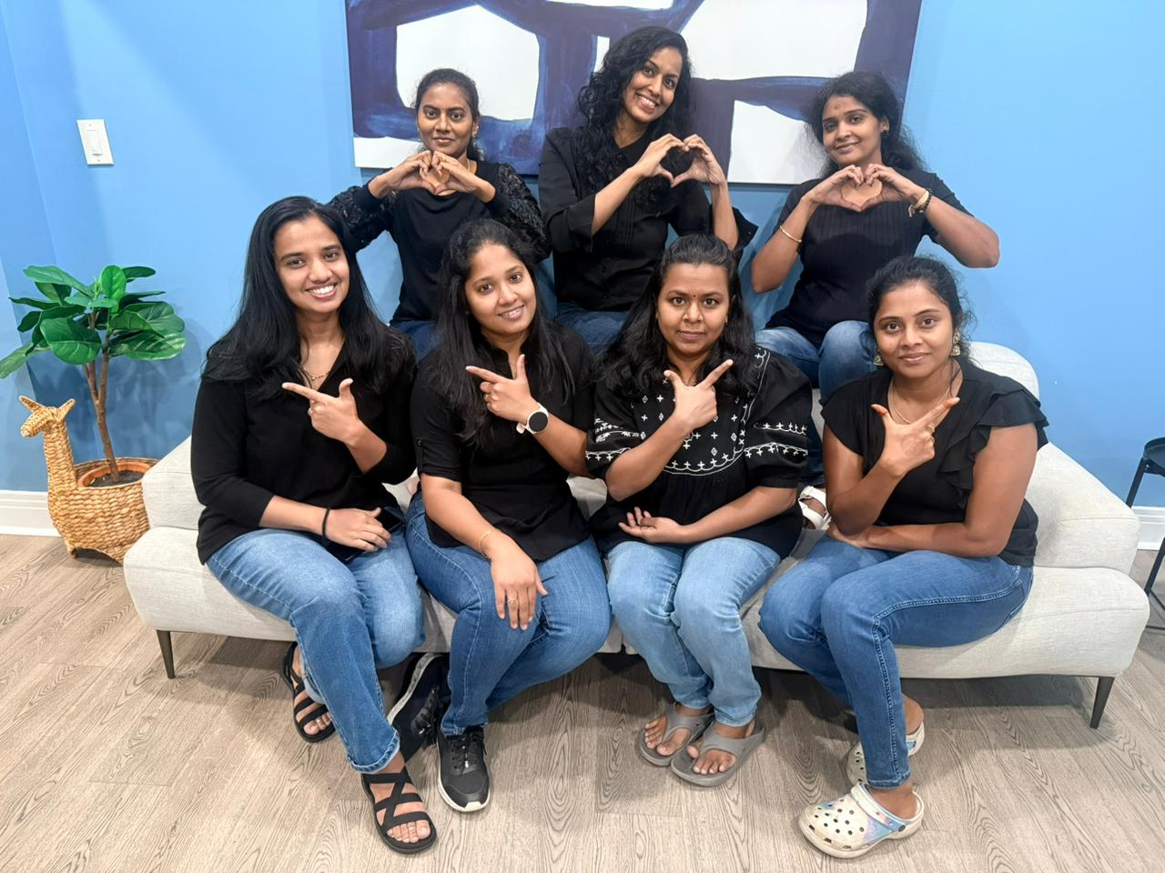
Anitha M Nagaraj Barani Vinothkumar Hemamalini Prabha Shanmugam
Ramya Oruganti Sangeetha Rajendran Selvakumari Anbalagan Usha Kaveri
DK32
Notes:
Image not found. ImageFile=''. Also tried from SlideName='DK32'. Searched in: ['/Users/AB74296/Downloads/DK PPT', '/Users/AB74296/Downloads/DK PPT/images', '/Users/AB74296/Downloads/DK PPT/imgs', '/Users/AB74296/Downloads/DK PPT/photos']

Slide 12
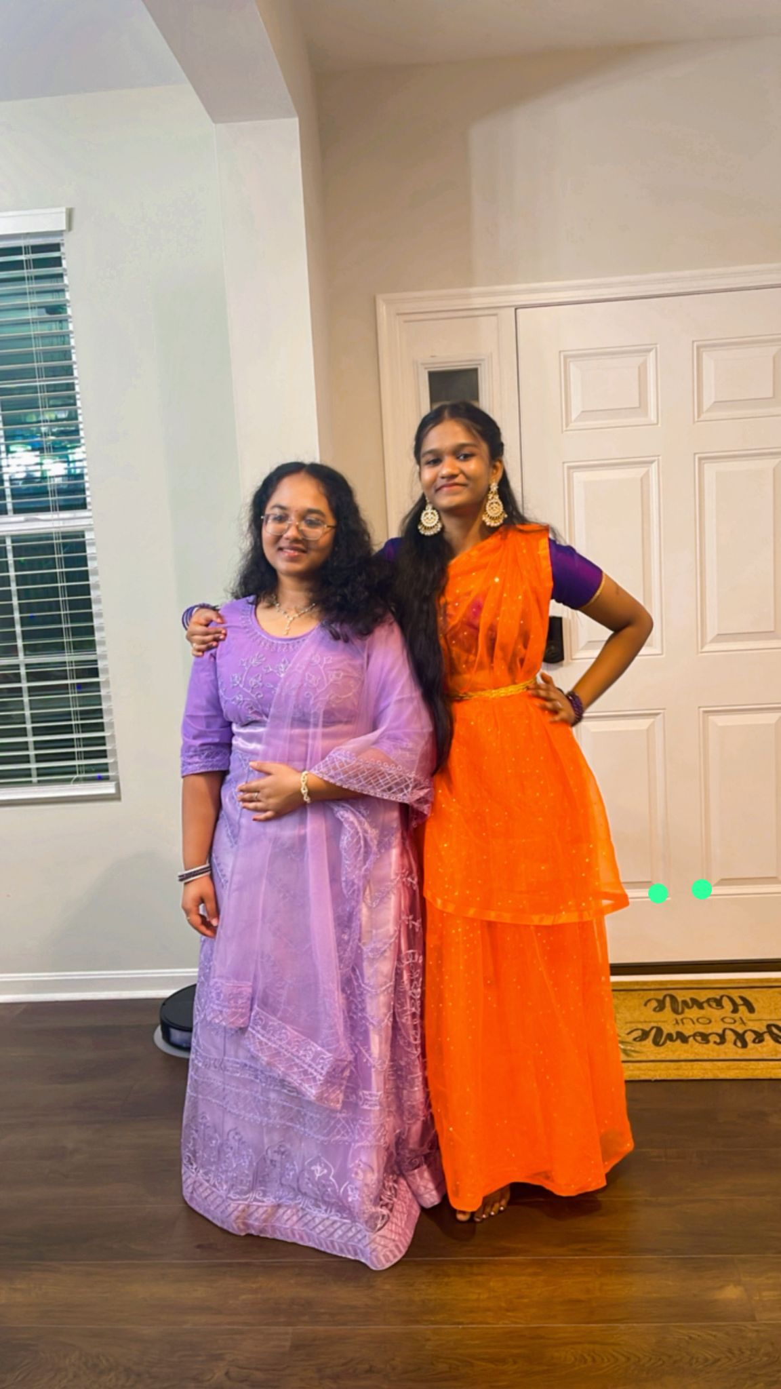
Kavyasree M S
Luckshenya M S
DK04
Notes:
Image: DK04.jpg

